Slide 1

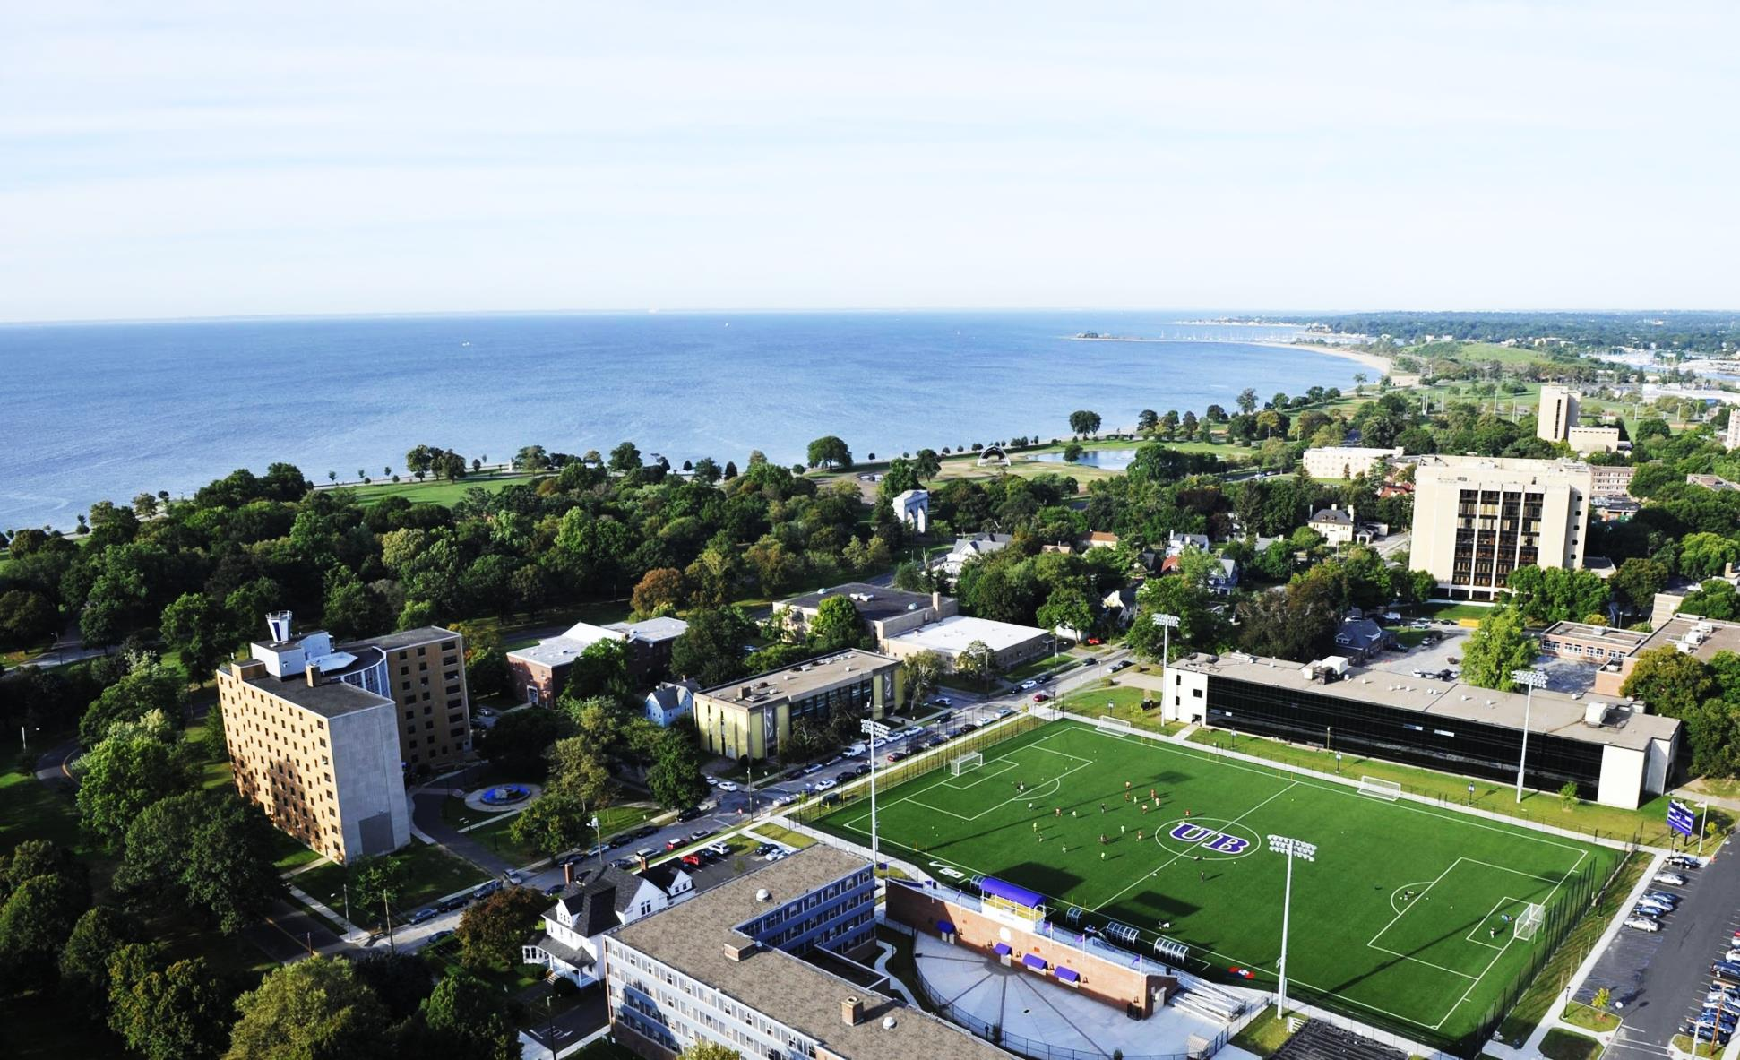

Slide 2

UBelong here!
Founded in 1927
Small, private university
Greater New York City area
Fully accredited institution
Undergraduate & Graduate
Student body representing 80 countries

Slide 3
1 hour from New York City (80 km)
2.5 hours from Boston, Massachusetts (260 km)
5 hours from Washington D.C. (465 km)
New York City
Bridgeport
Notes:
Excellent transportation system includes: Campus shuttle, City bus system, Metro North Rail system, easy access to I-95

Slide 4
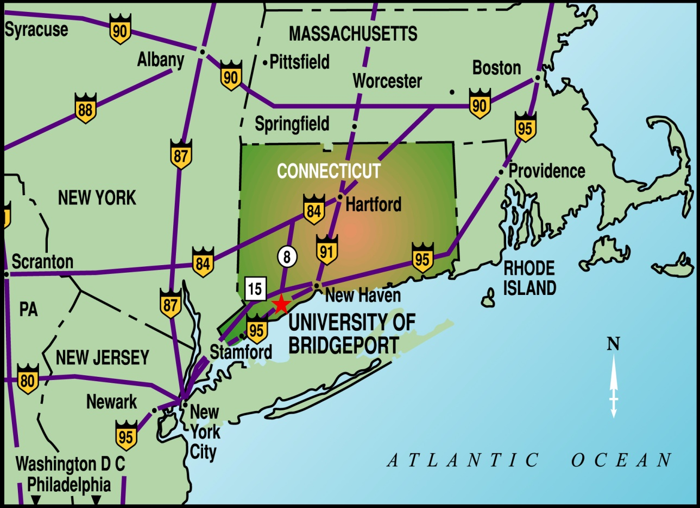
IDEAL LOCATION!!!
Fairfield County is known as the ‘Corporate Gold Coast’ - 3rd highest concentration of Fortune 500 companies in USA

Slide 5
UB’s 5,000 students
Notes:
About 5,000 students total
Appx 1200 International Students
2,400 Ugrad students- 400 are Intnl
2,600 Grad students- 800 are Intnl

Slide 6
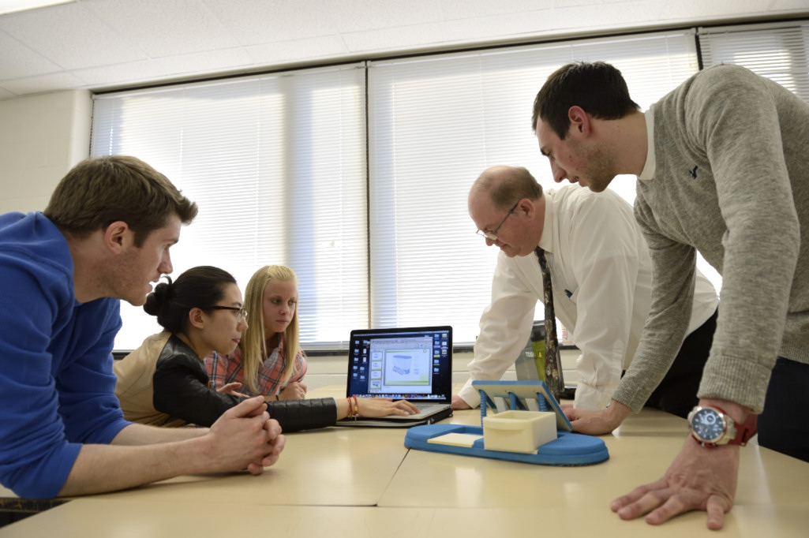
16:1 Student/Faculty Ratio
Notes:
Ave. Class size is 17. Higher numbers in gen eds, lower numbers in labs, specialty classes, etc. One-on-one time with professor- REAL relationships with teachers

Slide 7
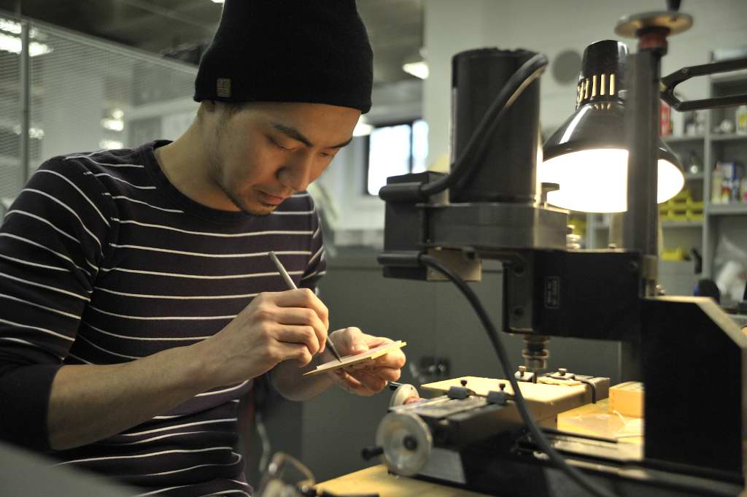
UB’s Programs
UB offers over 120 programs of study
and concentrations
School of Business
School of Engineering
College of Public and International Affairs
Shintaro Akatsu School of Design
School of Arts & Sciences
Division of Health Sciences
English Language Institute
ESL and conditional admission are offered

Slide 8

SCHOOLS/COLLEGES/INSTITUTES
School of Business | School of Engineering | Shintaro Akatsu School of Design | School of Arts & Sciences (Includes a new two year Pre-Pharmacy Program in collaboration with UCONN's School of Pharmacy) | School of Continuing & Professional Studies
College of Naturopathic Medicine | Nutrition & Acupuncture Institutes | College of Chiropractic | Fones School of Dental Hygiene | Physician Assistant Institute (in collaboration with Fairfield County Hospitals)
School of Nursing | College of Public & International Affairs | School of Education & Human Resources | ELI – English Language Institute
“Opening Doors, Building Futures”

Slide 9




ACCREDITATIONS
The University of Bridgeport is fully accredited by the New England Association of Schools and Colleges
The University is accredited by the Board of Governors of the Connecticut Department of Higher Education
The School of Business is accredited by the Association of Collegiate Business Schools and Programs (ACBSP)
Undergraduate Programs in the School of Engineering is accredited by the Accreditation Board for Engineering and Technology (ABET)

Slide 10
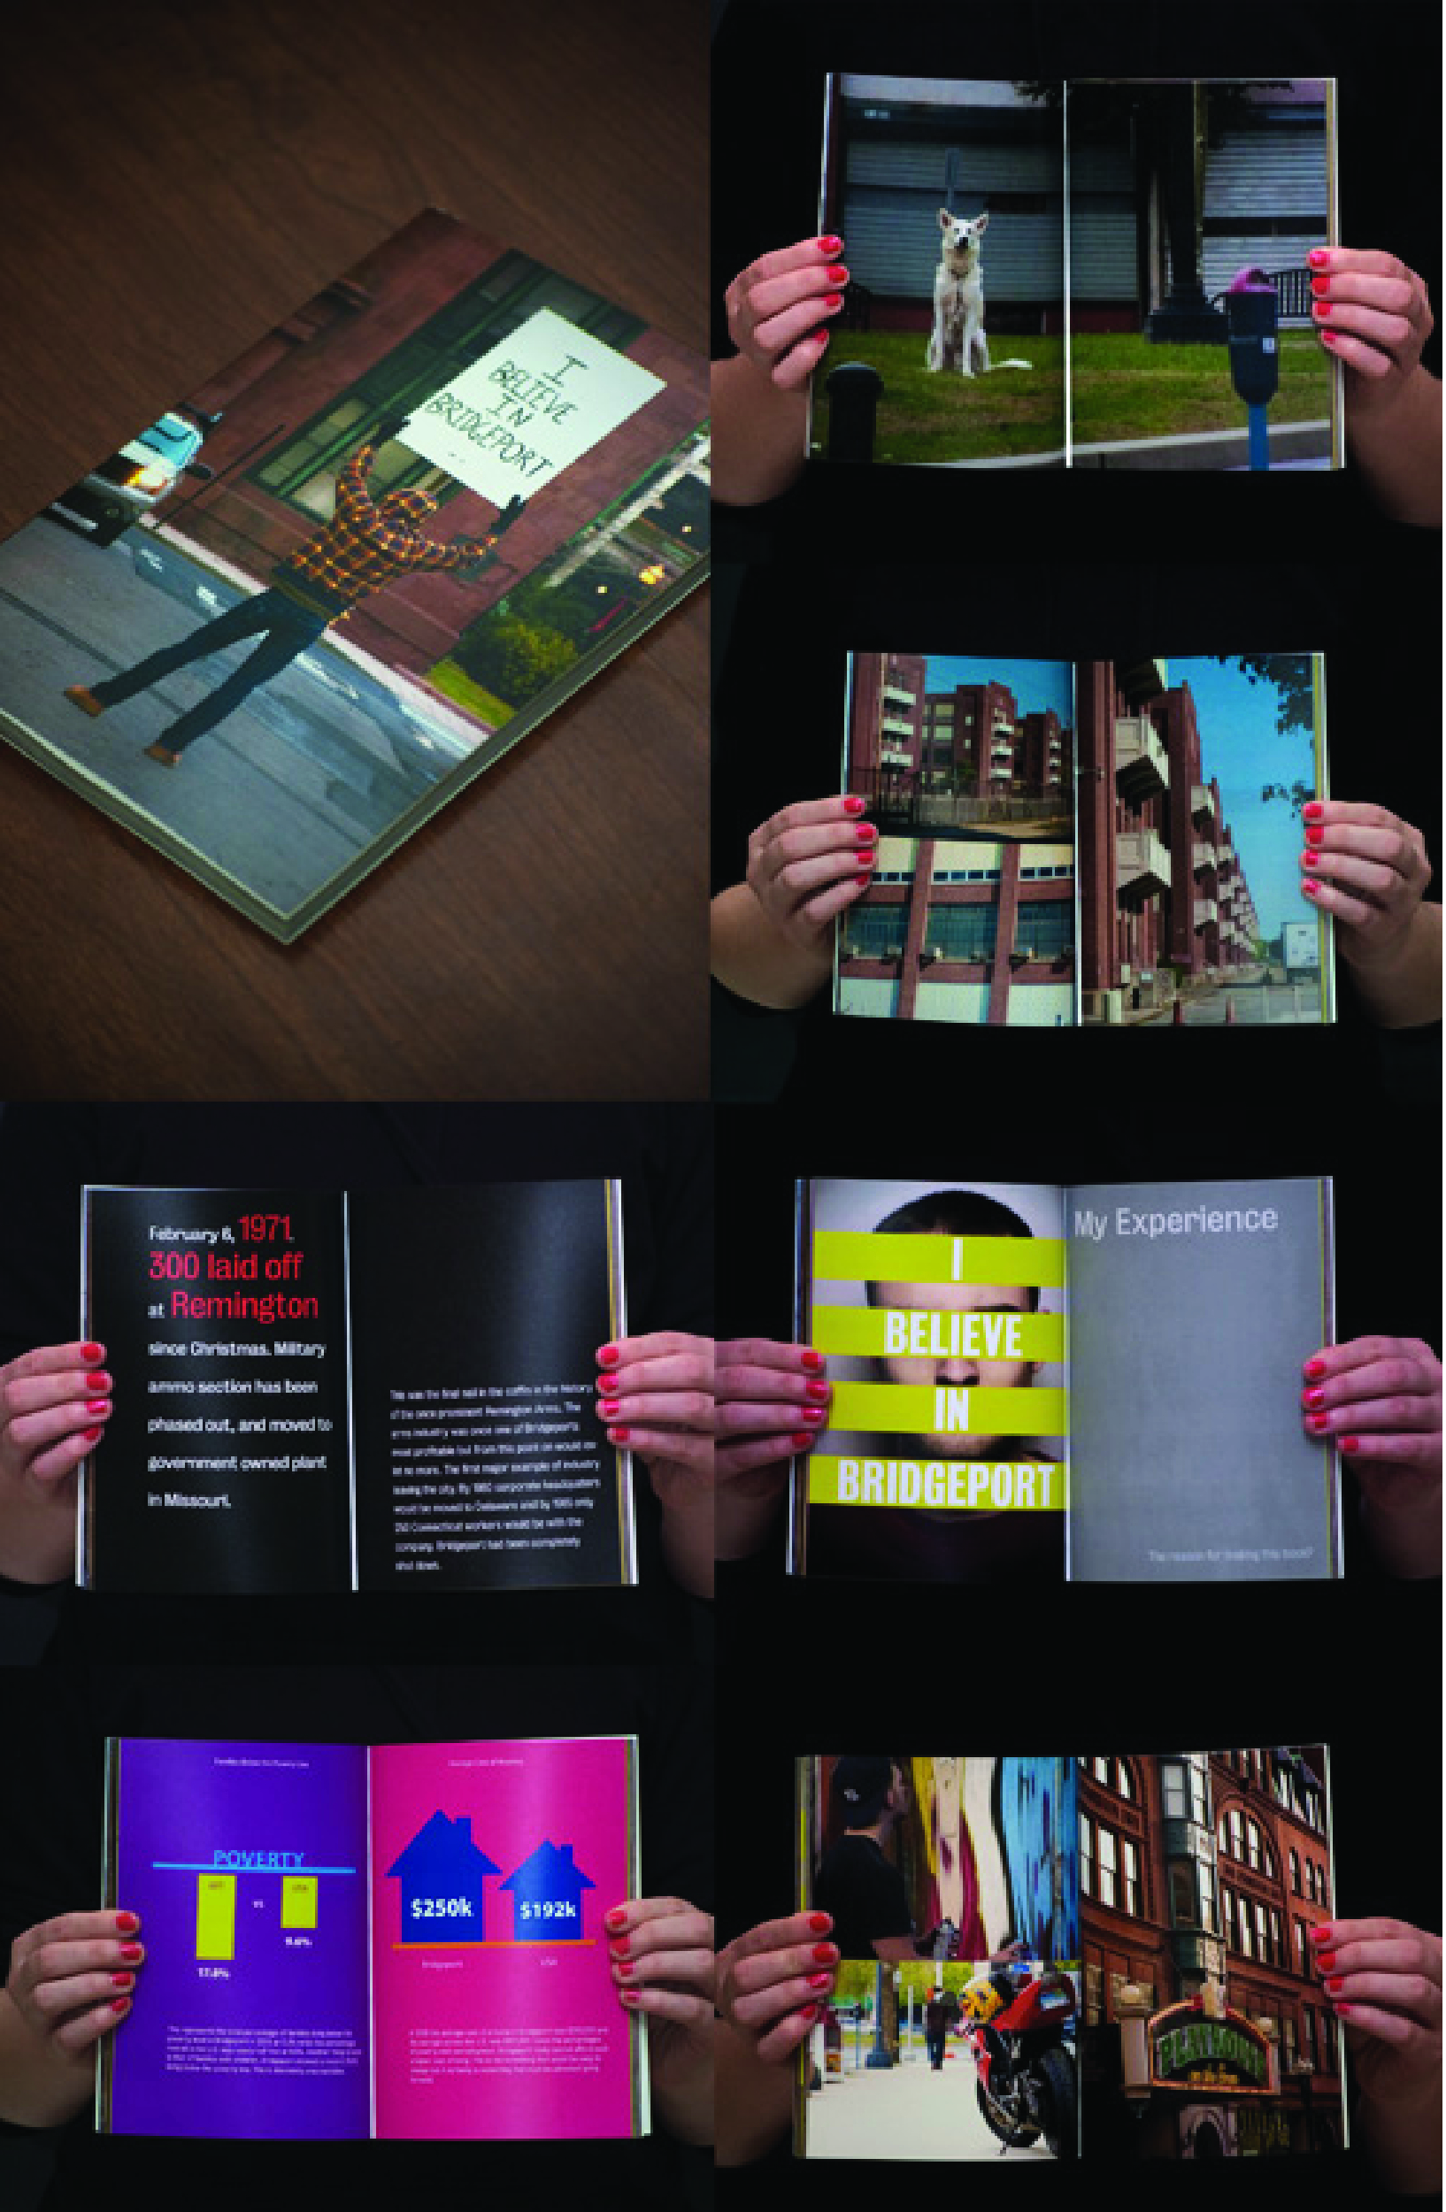
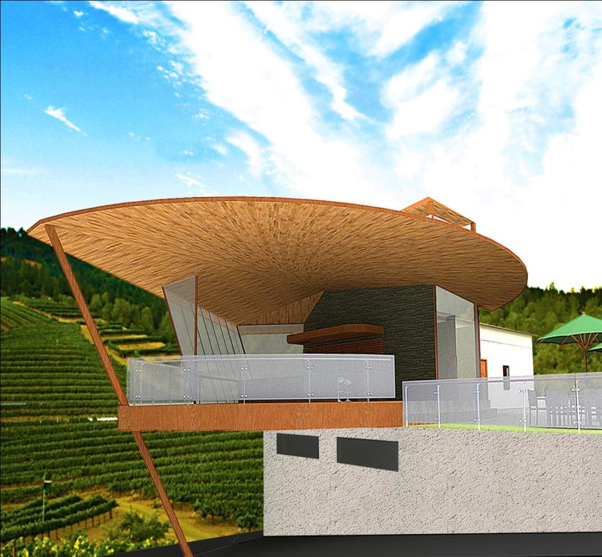
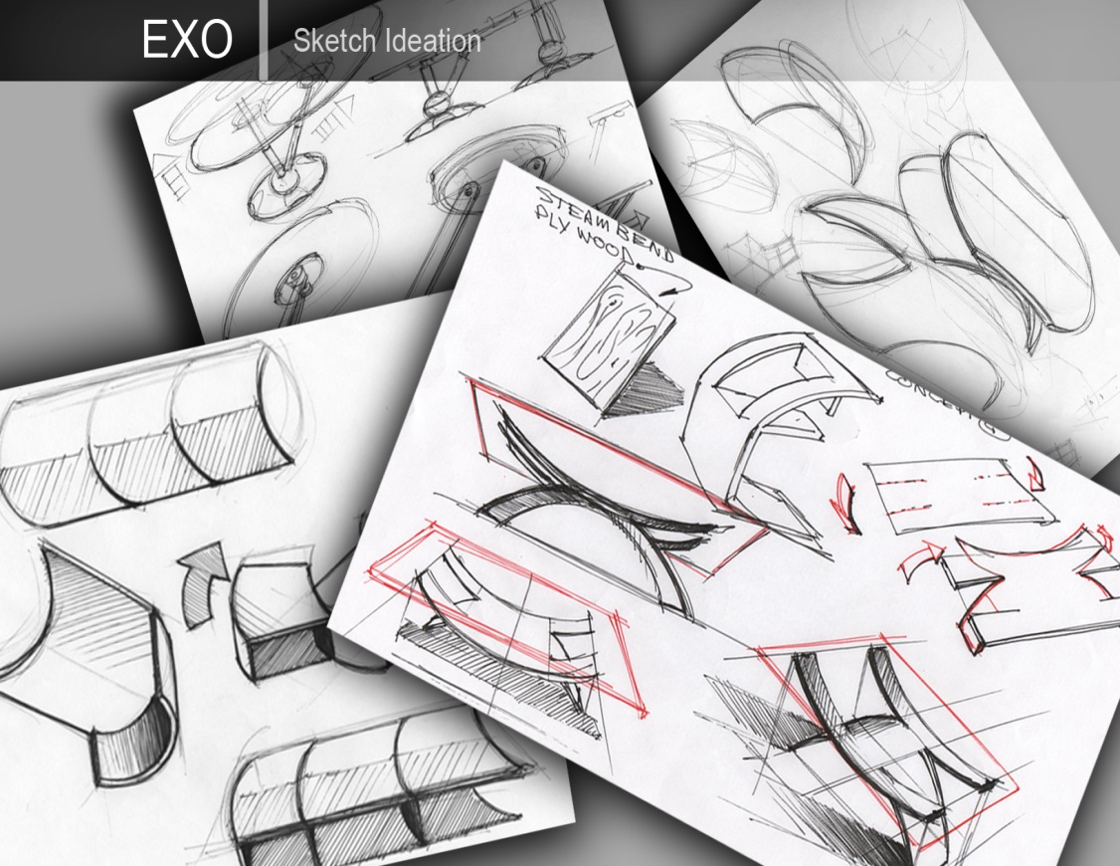
Shintaro Akatsu School of Design
BFA Graphic Design
BS Industrial Design
BS Interior Design
MPS Design Management

Slide 11

A truly international experience
The College of Public & International Affairs offers 6 distinctive Bachelors of Arts program and 3 globally focused Master’s programs
Focus on cultural literacy, effective communication & research
Solid academic prep for careers in international public service
Privileged access to the United Nations & NGO consultative status

Slide 12
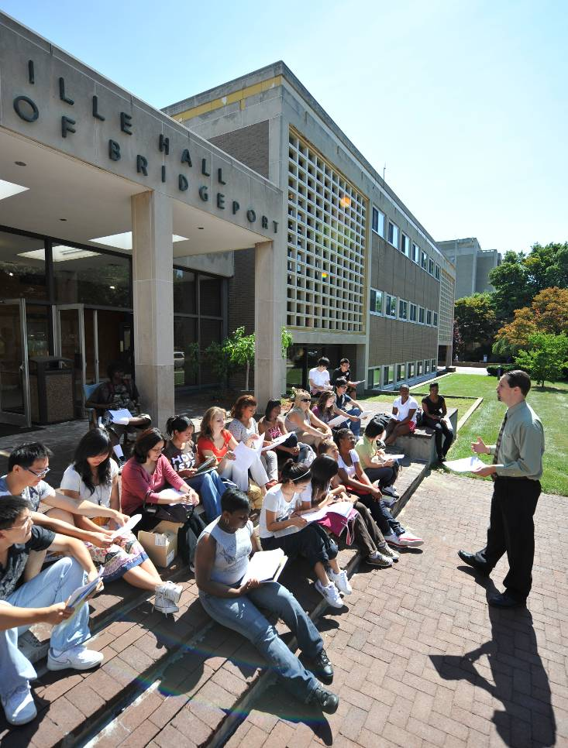
English Language Institute ELI
Experienced and caring instructors with advanced degrees
Special Orientation
Program structure: 6 levels (2 months each session)
Weekend trips to New York City, Niagara Falls, & Washington, D.C. and beach outings, winter ski trips

Slide 13
Scholarships & Financial Aid
Undergraduate
Graduate
Academic Scholarships
$10,000 to $15,000 per year
$3,000 to $5,000 for first year*
Assistantships, student worker employment, and co-ops available after first year
Scholarships not Available for ESL
All F-1 students are eligible for on-campus employment
Scholarships based on academic merit and English language proficiency
* For applicants to Master’s programs in School of Business, School of Engineering, and College of Public and International Affairs

Slide 14
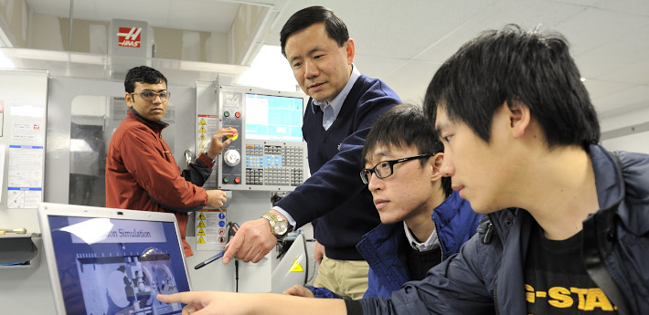

Engineering for the future
Award-winning programs and extensive research opportunities
Fastest growing engineering school in New England
One of the highest placement rates in the country
Generous scholarships, assistantships, and work-study available

Slide 15

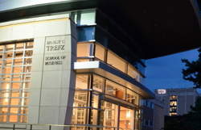
A Career-Oriented Business Program
Solid balance of academic theory and real-world practice
Professors with extensive business experience
Adaptable programs keeping up with changing times
Additional services: Resume-building, interview practice,
career fairs, etc…
Notes:
Note that additional services come largely from Career Services- but the school and dept work closely together.

Slide 16
HIGHLIGHTS – SCHOOL OF BUSINESS @ UB
Multiple areas of expertise: accounting, finance, international, human resources, management, and marketing
All courses taught by professors with terminal degrees, extensive work experience, or both
History of award winning student teams (e.g. CT Business Plan Competition, Stock Market Competition)
Interdisciplinary programs with Engineering, College of Public & International Affairs & Shintaro Akatsu School of Design
Clubs and extracurricular activities, such as volunteer tax preparation , investment and chess club, SCORE chapter, etc.
MBA program offered onsite and online

Slide 17
GRADUATE DEGREE PROGRAMS IN ENGINEERING
M.S. in Biomedical Engineering
M.S. in Computer Science
M.S. in Computer Engineering
M.S. in Electrical Engineering
M.S. in Mechanical Engineering
M.S. in Technology Management
M.B.A. (Business Administration)
Ph.D. in Computer Science & Engineering
Ph.D. in Technology Management

Slide 18

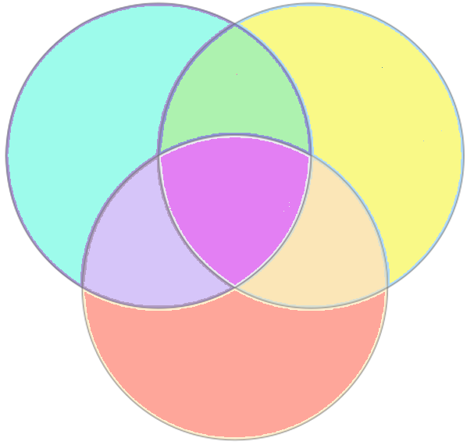
Technology Management Focuses on Three Major Interdisciplinary Areas - Management and Leadership, Engineering and Technology, and Business, Process, Functional and Analysis Competencies
Business, Industry, Process, Functional and Analysis
Skills
Management, Leadership, People and
Team Building Skills
MBA
TM
Technical and
Engineering Skills
TM = 3 Competencies
MBA = 2 Competencies
18

Slide 19
ENGINEERING Laboratories
Robotics Intelligent Sensing & Control (RISC) Lab
Advanced digital design and VLSI / FPGA Lab
Advanced networking and telecommunications Lab
High Performance Computing Lab
Power Electronics Lab
Biomedical Engineering Lab
Programmable Logic Control (PLC) Lab
Signal and Speech Processing Lab
Digital/Biomedical Embedded Systems & Technology Lab
3D Modeling, Design & Printing Lab

Slide 20
HIGHLIGHTS – SCHOOL OF ENGINEERING @ UB
The School of Engineering is internationally renowned for its inter-disciplinary programming and also offers many research and graduate concentrations, certificates, and two degree opportunities within several multi disciplinary fields of study.
According to U.S. News, in 2014 UB’s IT program, which includes master’s degree programs in computer science and technology management, was ranked 11th best in the nation. UB ranked 29th in both the online bachelor’s and graduate engineering categories.
Sponsored research funding at the School of Engineering has quadrupled in the last three years. The school houses several research centers and laboratories that are internationally renowned.
SOE students have been awarded all the 1st, 2nd & 3rd place awards for the graduate research project competition at the 2013 North East American Society of Engineering Education (ASEE) conference.
Select concentrations prepare students for industry certification exams (E.g. PMP, etc.)
UB has one of the highest job placement rates.

Slide 21
RESEARCH AREAS – TECHNOLOGY MANAGEMENT
Analytics, Modeling & Simulation
Bio-Medical/ Bio-Technology and Management
Entrepreneurship, Intrapreneurship & New Venture Creation
Creating & Sustaining High Performance Global Leaders and Teams
New Product/Service Development and Commercialization
Strategic Marketing, Demand Creation, Growth and Innovation
Information Technology
Outsourcing and Strategic Sourcing
Quality Management and Lean Process Management
Program and Project Management
Supply Chain Management & Logistics
Information Technology Strategy, Execution & Governance
Manufacturing Management
Service Management
Engineering and Science Management
Technology Development

Slide 22
RESEARCH AREAS – BIO-MEDICAL ENGINEERING
Biomedical materials
Biomimicking and bioinspired materials
Bioelectronics
BioMEMS
Biosignal processing
Biorobotics
Bioimage processing
Ergonomy
Bioinformatics
Gene sequencing
Communication in man-machine interface
Biosensing
Tissue Engineering
Cellular and molecular biology
Biometrics
Biomechanics
Biotechnology

Slide 23
RESEARCH AREAS - COMPUTER SCIENCE & ENGINEERING
Automation and Manufacturing
Biomedical Engineering
Computer Architecture
Computer Arithmetic
Computer Networks
Control Systems
Digital Signal Processing & Image Processing
Formal Approaches for Design, Synthesis and Verification
Microelectronic Design
Multimedia Data Base Application
Parallel and Distributed Architectures and Algorithms
Robotics
Scalable Web Architectures, SOA, GPS Applications.
Wireless Communication

Slide 24
RESEARCH AREAS - ELECTRICAL ENGINEERING
Distributed control and optimization
Electrical Properties of Plastic/Metal Composites
Electrical Safety and Electric Accident reconstruction
Electromagnetic Fields Applied To Lightning
Electronic Biological Sensors
Electronic Materials and Devices
Information processing and control of large-scale distributed systems
Medical Electronics & Bio-Medical
Micro-electromechanical Systems (MEMS)
Micro-sensors and Micro-actuators
PLC (Programmable Logic Control)
Superconductors
Thin-film Solar Cells
VLSI design and testing

Slide 25
RESEARCH AREAS – MECHANICAL ENGINEERING
Automation control
Aerodynamics and hydrodynamics in sports
Biomechanics, biofluids, biomaterials & biomedical device design
Computational fluid dynamics
Computer Aided Design/ Engineering/ Manufacturing
Design optimization
Finite element analysis
HVAC
Laser material processing
Materials Engineering and Composites
Mechatronics & robotics
MEMS & nanotechnology
Modeling and simulation of manufacturing process
Rapid prototyping
Solar energy and fuel cells
Thermal management of electronic devices and systems
Vehicle aerodynamics
Welding

Slide 26
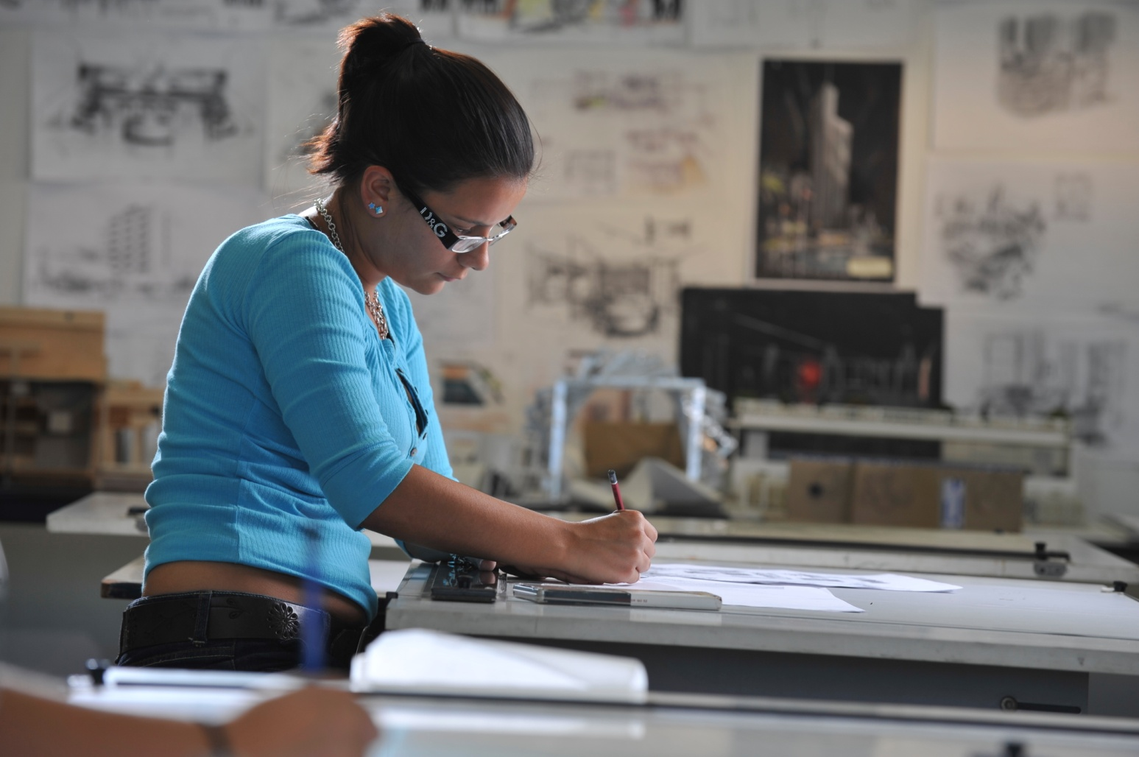
STUDENT EMPLOYMENT
Career Center
On-Campus Employment – over 600 student jobs per semester
Career Services - Job Search & Resume Development Assistance
Career Fairs and Campus Recruiting
Job and Internship Listings
CPT (Curricular Practical Training)
OPT (Optional Practical Training)

Slide 27
FINANCIAL STIPENDS AND SCHOLARSHIPS
Graduate Assistantships, Research Assistantships and Student Worker employment available (600-700 on-campus jobs).
Graduate Scholarship Program available for incoming domestic and international graduate students with award amounts of $3,000, $4,000, $5,000 and $6,000 per academic year for the first year graduate students in select schools. Eligibility for the award is based on the student’s record of academic achievement & test scores.
Undergraduate Academic Scholarships - $10,000 to $15,000 per year.
All F-1 students are eligible for on-campus employment.
Scholarship based on academic merit and other factors.

Slide 28






















SELECT UB ALUMNI EMPLOYERS

Slide 29


A Partnership of:
Connecticut Innovations Inc. (CI)
&
University of Bridgeport (UB)

Slide 30
Value Proposition/Objectives
Nurture and facilitate growth of new businesses and jobs in high technology and technology ventures
Foster and stimulate economic development and job creation in Greater Bridgeport, Fairfield County and the State of Connecticut
Support and enable the growth and commercialization of UB’s applied research & Intellectual Property initiatives (e.g. U.S. Army Hybrid Projectile Design initiative – part of $2.4 million grant; NSF Smart Browsing Systems for Endoscope videos – $147,655 pending grant)
Build synergy and collaboration among industry, education and government sectors
Become self-sustaining: generate revenues through rent income, IP royalties, license fees, sponsor contributions, grants, donations, etc.
Leverage educational, faculty, student interns and facility resources for career and economic development

Slide 31
Target Market – CTech IncUBator @ University of Bridgeport
Greater Bridgeport / Fairfield County / Connecticut:
New start-ups
Early stage companies
Connecticut Innovations Portfolio Companies
UB Students / Faculty:
School of Engineering
School of Business
Schools of Health Sciences
Shintaro Akatsu School of Design

Slide 32
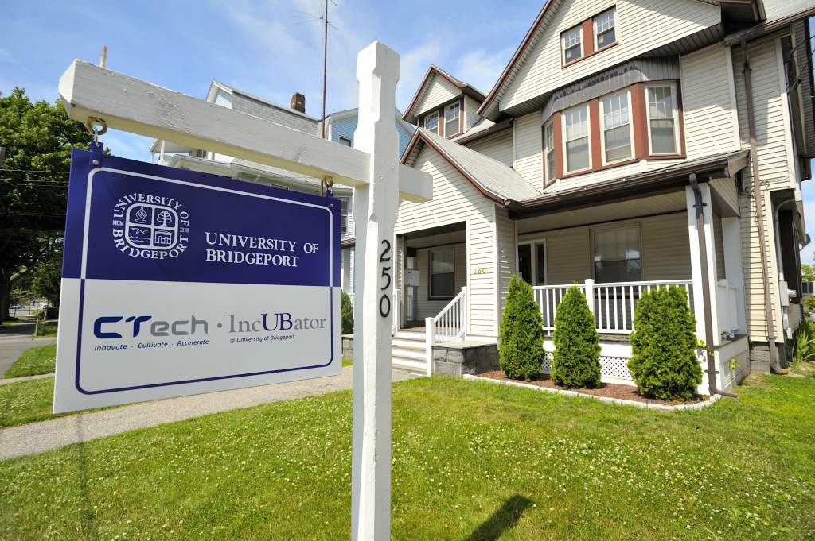
CTech IncUBator
250 Myrtle Avenue, Bridgeport, CT 06604
Six offices ranging from 130 to 240 sq. ft.
Shared conference room with Monitor
Shared Kitchen
Internet Access and Utilities included in rent
Security camera linked to UB security
Shared Copy/Fax/Printer

Slide 33
CTech IncUBator Tenant Services & Resources
Favorable market rents in a high-energy, entrepreneurial environment. Rent includes utilities
Shared support services (e.g. conference room, high speed internet connectivity, printer/copier/fax/scanner and a kitchen)
Pro-bono and discounted professional services assistance (e.g. legal, accounting, intellectual property, technology, product commercialization and SCORE advisors)
An entrepreneurial environment conducive to exchanging information, ideas and solutions
Access to facilities and resources like the library, gym, pool, café, coffee bar, world class laboratories and many more located on campus
Introductions to potential investors and pre-seed and seed funding programs
Access to public and private grant and joint research opportunities
Access to world class faculty members and exceptional student interns
Monthly “Entrepreneurial Brown Bag Lunch” free seminars and events

